Slide 1



TOM HOLLAND

Slide 2
Name: Year: 1ˢᵗ year Dept.: CSE(IoT)
Roll No.:
Subject name: Language Laboratory Subject code: HMHU291
FUTURE INSTITUTE OF TECHNOLOGY

Slide 3


Table Of Contents
1
2
3
4
5
6
7
8
9
Acknowledgement
Who is Tom Holland
Landed on Earth
Education
Early Life
Debut Film
First Big Break
Awards and Achievemnets
Upcoming Movies

Slide 4


ACKNOWLEGEMENT
I would like to express my special thanks of gratitude to my teacher Mr. Arnab Chakraborty, who gave me the golden opportunity to do this wonderful project of Who also helped me in completing my project. I came to know about so many new things I am really thankful to them.
Secondly i would also like to thank my parents and friends who helped me a lot in finalizing this project within the limited time frame.
.
K. Divyansh

Slide 5
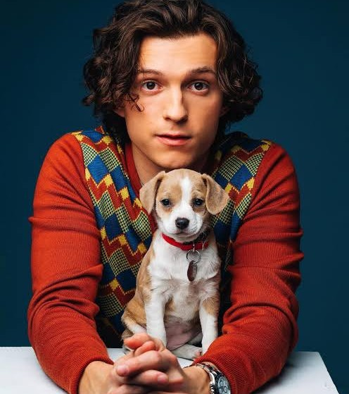


Who is
Tom Holland
Thomas Stanley Holland was born to Nicola Elizabeth (Frost), a photographer, and Dominic Holland (Dominic Anthony Holland), who is a comedian and author. His paternal grandparents were from the Isle of Man and Ireland, respectively. He lives with his parents and three younger brothers - Paddy and twins Sam and Harry.

Slide 6

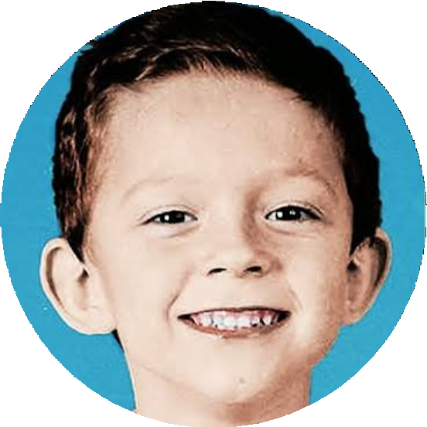

Landed on Earth
Tom Holland was born on 1 June 1996 (age 26 years), in a town named Kingston upon Thames, United Kingdom.

Slide 7
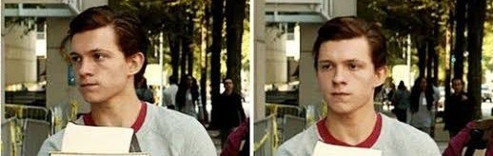


EDUCATION Tom attended Donhead Prep School. Then, after a
successful eleven plus exam, he became a pupil
at Wimbledon College. Having successfully completed his GCSEs, in September 2012 Tom started a two-year course in the BRIT School for Performing Arts & Technology notable for its numerous famous alumni

Slide 8

EARLY LIFE
Growing up, Holland considered several career choices. As a child, he was a fan of Janet Jackson's songs, and would often dance to them. His mother, impressed with this, signed him up for a dancing class, which was advertised in the private school that Holland was visiting at the time. In his teens, Holland briefly attended carpentry school in Cardiff, Wales. At one point, he considered becoming a primary school teacher, as he enjoys being around children.

Slide 9
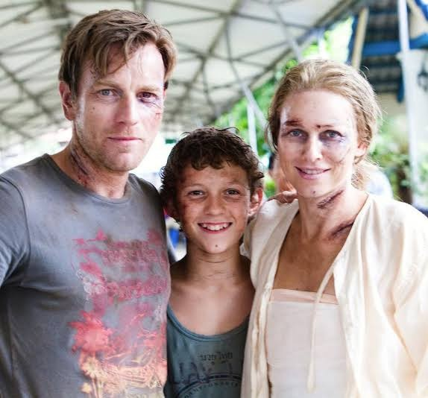

DEBUT
Tom Holland made his film debut in the disaster drama The Impossible (2012) as a teenage tourist trapped in a tsunami, for which he received a London Film Critics Circle Award for Young British Performer of the Year.

Slide 10


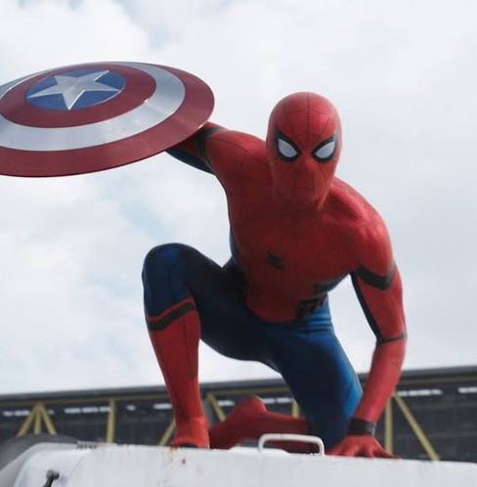

First BIG BREAK
In 2015, Tom was cast as Peter Parker/Spider-Man in Sony and Marvel's films. He has played the role in Captain America: Civil War (2016) which paved his way not only in Sony and Marvel's films but also in Hollywood.

Slide 11
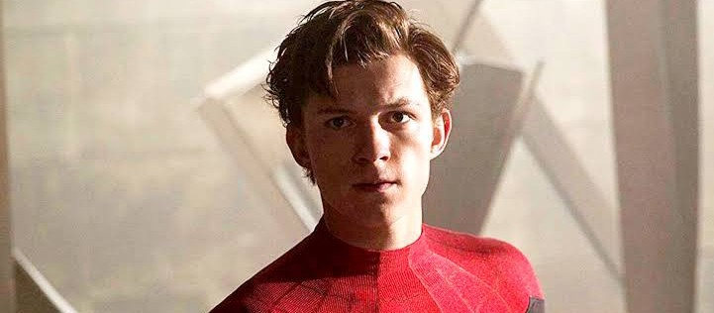



His accolades include a British Academy Film Award, three Saturn Awards, a Guinness World Record and an appearance on the Forbes 30 Under 30 Europe list. Some publications have called him one of the "most popular actors of his generation".
AWARDS AND ACHIEVEMENTS

Slide 12
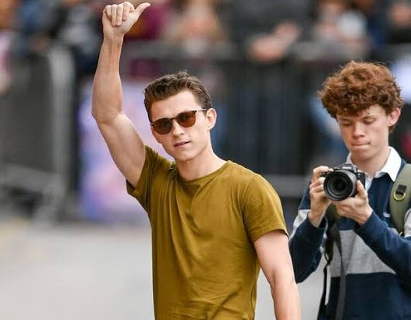



UPCOMING
MOVIES
Beneath A Scarlet Sky The Crowded Room
MCU Spider-Man Movies After No Way Home (TBD)
Untitled Fred Astaire Biopic (TBD)

Slide 13

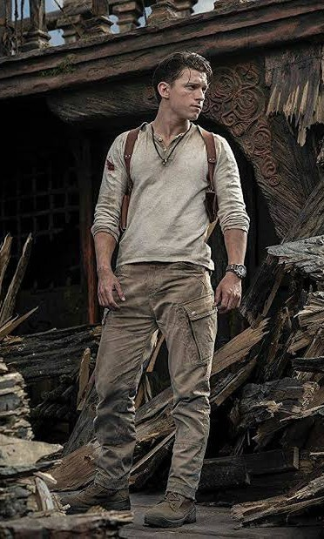
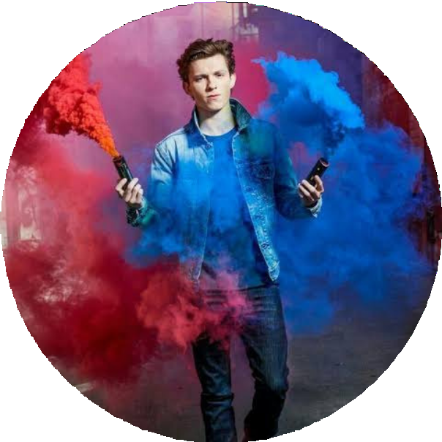

The harder you try, the better the impression you set on the people around you.
The most important thing, in anything you do, is always trying your hardest, because even if you try your hardest and it's not as good as you'd hoped, you still have that sense of not letting yourself down.
-TOM HOLLAND

Slide 14




Source
en.m.wikipedia.org www.google.com m.imdb.com

Slide 15

Thank You

